Slide 1
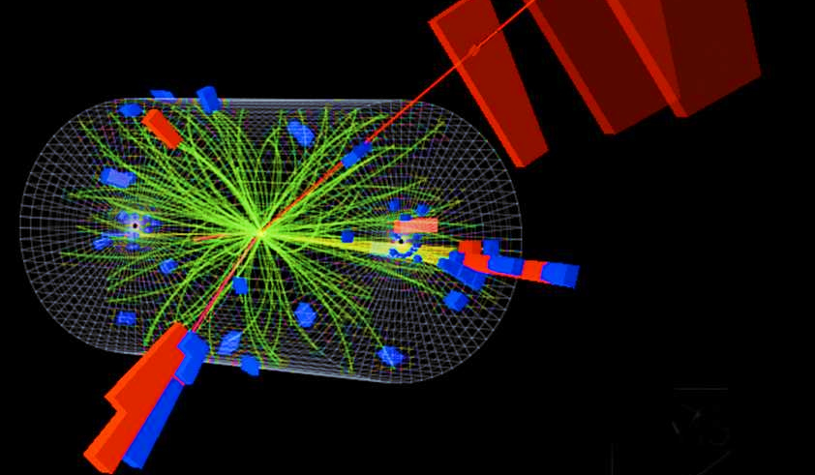
Particle Physics Events Classification Using Machine Learning
Name : D.Hariharasudhan

Slide 2
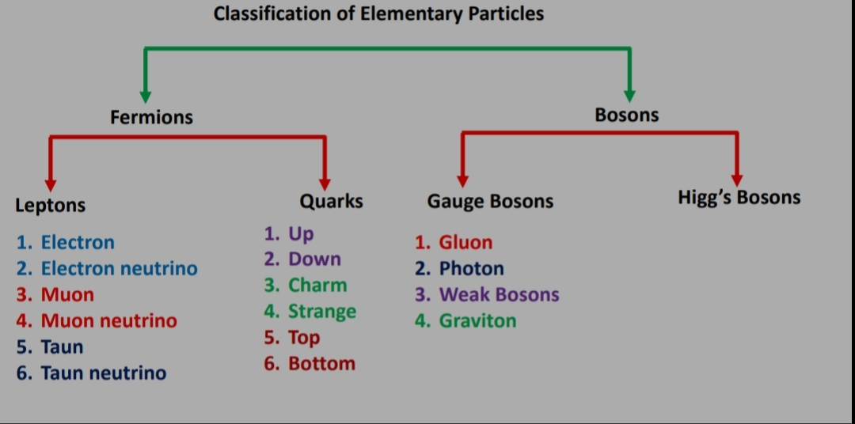

Slide 3
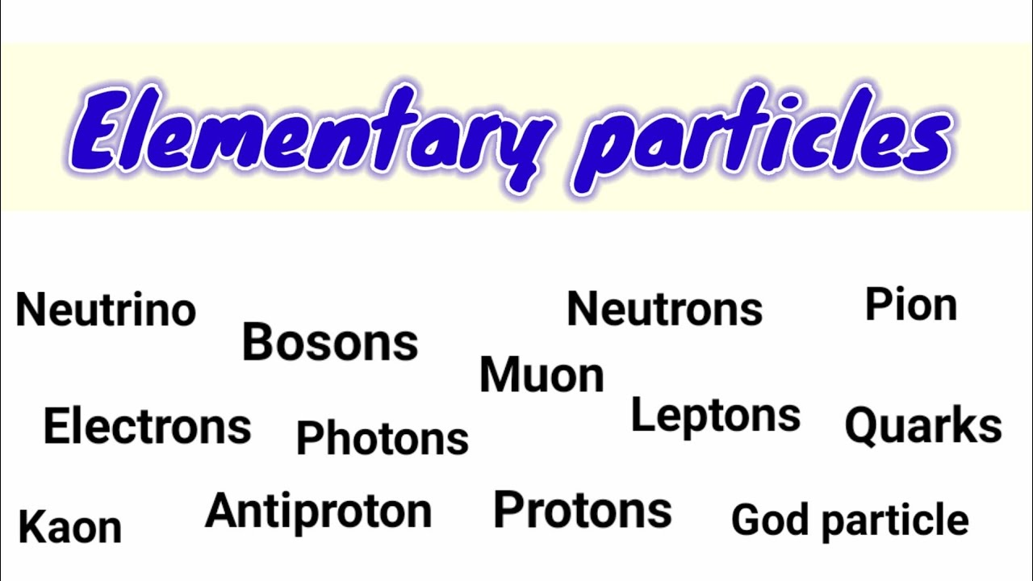

Slide 4
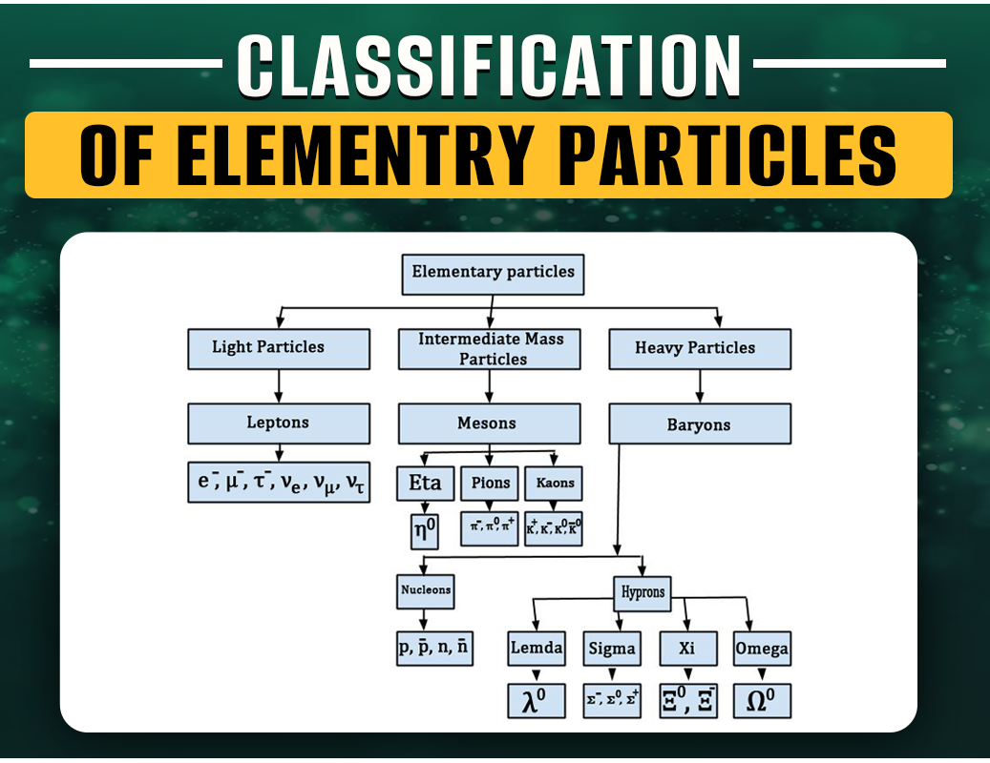

Slide 5
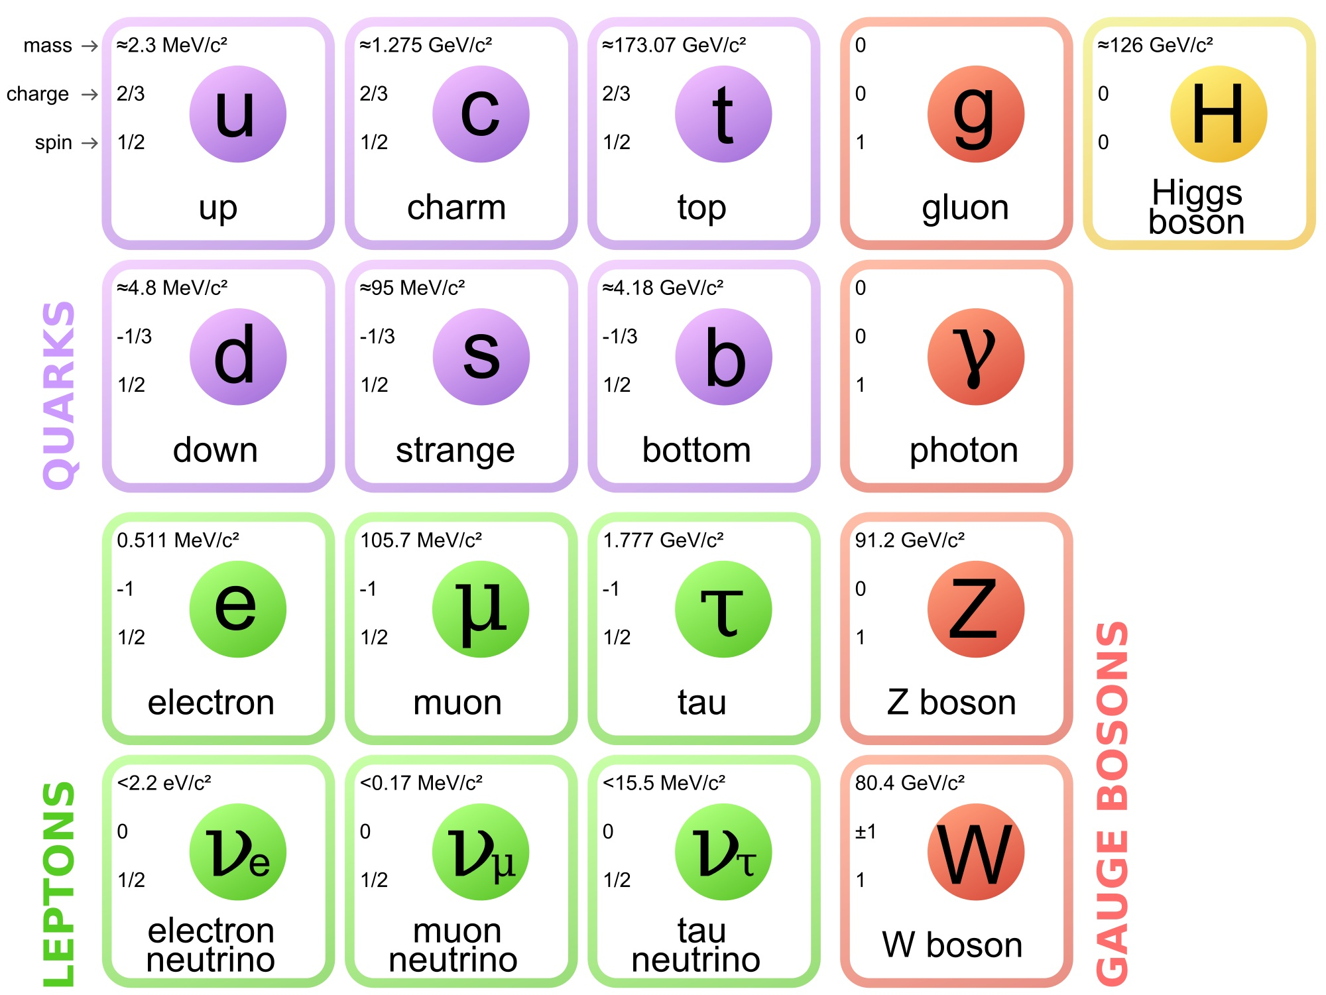

Slide 6
A problem from particle physics. We have chosen the particular problem posed in this competition. In particle physics, an event refers to the results just after a fundamental interaction takes place between subatomic particles, occurring in a very short time span, at a well-localized region of space. The problem is to classify an event produced in a particle accelerator as background or signal, based on relevant feature variables. A background event is explained by the existing theories and previous observations. A signal event, however, indicates a process that cannot be described by previous observations and leads to the potential discovery of a new particle.

Slide 7
What Are Particle Physics Events?
Imagine a gigantic particle collider, like the Large Hadron Collider (LHC). It smashes tiny particles (like protons) together at incredible speeds.
When these particles collide, they create a chaotic mess of other particles. These messy collisions are called events.
Scientists study these events to understand the fundamental building blocks of the universe.

Slide 8
Particle physics events refer to interactions or phenomena that occur within the realm of particle physics, which is the branch of physics that studies the fundamental constituents of matter and the forces acting between them.
These events typically involve the interactions of subatomic particles such as electrons, protons, neutrons, and various types of quarks, leptons, and bosons. Particle physics experiments often involve colliding particles at high energies and studying the resulting interactions to understand the fundamental properties of matter and the forces that govern the universe.
Particle physics events can include:Particle Collisions: In particle accelerators such as the Large Hadron Collider (LHC), high-energy particles are collided together, creating a cascade of secondary particles. The detection and analysis of these secondary particles provide insights into the fundamental forces and particles.

Slide 9
Decays: Subatomic particles can decay into other particles, often as a result of weak nuclear interactions. Studying the properties of these decays helps physicists understand the underlying symmetries and interactions in nature.
Particle Production: In high-energy collisions, new particles can be produced that are not present in everyday matter. These particles may be short-lived and decay rapidly into more stable particles, but their properties provide crucial information about the fundamental forces and particles.
Interactions with Detectors: Particle physics experiments often involve sophisticated detectors that can track the paths of particles, measure their energies, and identify their properties. Events recorded by these detectors provide data that physicists analyze to understand the fundamental nature of matter and energy.Rare Processes: Some particle physics events involve extremely rare processes that occur very infrequently, requiring large-scale experiments and sophisticated detectors to detect and study.
Overall, particle physics events are fundamental to our understanding of the universe at its most fundamental level, providing insights into the nature of matter, energy, and the forces that govern the cosmos.

Slide 10
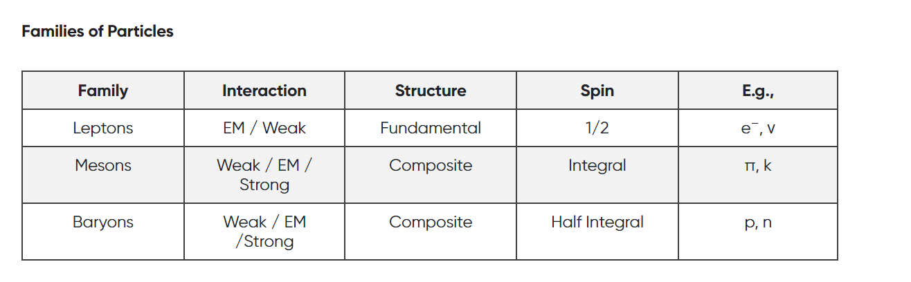

Slide 11
The Higgs boson, sometimes affectionately called the Higgs particle, is a remarkable elementary particle in the Standard Model of particle physics. Let’s break down what makes it so intriguing:
What Is It?
The Higgs boson is like a cosmic celebrity. It’s the carrier particle (or boson) associated with the Higgs field.
But what’s this Higgs field? Imagine it as an invisible field that permeates all of space. It’s like the cosmic glue that endows other tiny particles with mass.
Why Does Mass Matter?
Mass determines how much a particle resists changing its speed or position when it encounters a force.
Without mass, particles would zip around at the speed of light, and the universe would be a chaotic mess.
The Higgs Mechanism: Giving Mass to Particles
The Higgs field interacts with particles like electrons, quarks, and W/Z bosons.
When these particles move through the Higgs field, they gain mass. It’s like they’re wading through cosmic molasses.
The Higgs boson itself is a massive scalar boson (meaning it has zero spin) that couples to mass.

Slide 12
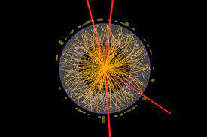
In the field of particle physics, accurate identification and classification of events are crucial for understanding fundamental particles and their interactions. The provided dataset contains various features derived from particle physics experiments, and the goal is to build a machine-learning model to classify events into signal (s) and background (b) categories. This classification aids in distinguishing events of interest (signal) from background noise.

Slide 13
Data Preprocessing:Assuming you have a dataset with features derived from particle physics experiments, here are the typical preprocessing steps:Handle missing values: Impute missing values using strategies like mean, median, or mode imputation.Encode categorical variables: Convert categorical variables into numerical representations using techniques like one-hot encoding or label encoding.Scale numerical features: Standardize numerical features to have mean 0 and standard deviation 1 to ensure all features contribute equally to the model.
Model Selection:For classification tasks in particle physics, you may consider the following models:Random ForestSupport Vector Machines (SVM)Gradient Boosting (e.g., XGBoost, LightGBM)Neural Networks (e.g., deep learning models)
Model Training:Once you've selected a model, you can train it on your preprocessed data.
Model Evaluation:Evaluate the trained model using appropriate evaluation metrics such as accuracy, precision, recall, F1-score, and ROC curves. You can use techniques like cross-validation to get a more robust estimate of model performance.
Model Tuning:Fine-tune the hyperparameters of the model using techniques like grid search or random search to optimize performance.Let's proceed with a Python example using scikit-learn for data preprocessing, model selection, training, evaluation, and tuning. We'll use a simple synthetic dataset for demonstration purposes.

Slide 14
Particle accelerators help physicists study fundamental particles through high-energy collisions.
Analyzing data from these collisions can be challenging due to its complexity and inherent uncertainties.
Machine learning assists by extracting meaningful information, improving statistical power, and reducing noise.
Standardized ML software packages provide tools for data analysis, enabling physicists to develop custom ML pipelines.
Collaboration between physicists and data scientists ensures robust and reliable results.
Overall, ML offers a simple yet powerful solution for enhancing our understanding of particle physics through accelerator experiments.

Slide 15
To prove that the Higgs field gives mass to particles like tau leptons, scientists need to show that the Higgs boson can directly decay into pairs of these particles. By studying how the Higgs boson breaks down into tau leptons, researchers can understand how particles acquire mass. This investigation is vital for unraveling the mysteries of particle physics and understanding the building blocks of our universe.

Slide 16
In particle physics experiments, scientists sift through huge amounts of data to find rare events that might indicate the presence of new particles or phenomena. They use sophisticated algorithms to quickly filter out common events, focusing only on the most interesting ones. After storing these selected events, they analyze them to identify any unusual patterns or excesses compared to what's expected from known processes.
By pinpointing regions in their data where there's an unexpectedly high number of events, scientists can run statistical tests to determine if these excesses are likely caused by new particles. If the probability of the excess being due to known processes is low enough, it could signal a groundbreaking discovery in physics.

Slide 17
In a particle physics experiment, scientists look at two types of data samples: the signal sample and the background sample.
1. Signal Sample: This contains events where Higgs bosons, with a specific mass, were produced. These events are what scientists are primarily interested in studying.
2. Background Sample: This sample includes events generated by other known processes that can look similar to the signal events but are not the main focus of the study. These background events help scientists understand what to expect from known physics.
By comparing the signal and background samples, scientists can separate the interesting events (the signal) from the ones that aren't as important for their study (the background). This helps them identify and study the Higgs boson effectively amidst all the other processes happening in the experiment.

Slide 18
In this scenario, we have a training set and a test set for a machine learning task:
1. Training Set:
- Contains 250,000 observations.
- Includes labels (signal or background) indicating the category of each observation.
- Also contains weights, which may indicate the importance or significance of each observation in the training process.
- Both sets share 31 common features.
- Used to train the machine learning model. The model learns patterns from the features and their corresponding labels, guided by the provided weights.
2. Test Set:
- Consists of 550,000 observations.
- Does not include labels or weights.
- Shares the same 31 features with the training set.
- Used to evaluate the performance of the trained model. The model's predictions on this set are compared against the actual outcomes (labels) to assess its accuracy and generalization ability.
By splitting the data into training and test sets, we can train the model on one set and evaluate its performance on another. This helps ensure that the model can make accurate predictions on new, unseen data, which is essential for its practical use.

Slide 19
The project objective is to develop a classification system that can distinguish between two types of events produced in the particle accelerator: background events and signal events.
Background Events: These events are well understood and can be explained by existing theories and previous observations. They represent known processes in particle physics.
Signal Events: These events indicate a process that cannot be described by previous observations. They are of particular interest because they could potentially lead to the discovery of a new particle or phenomenon.
The goal is to build a model that can accurately classify each event as either background or signal based on the features extracted from the data. By doing so, scientists can identify and prioritize events that may represent new and previously unknown physics, potentially leading to groundbreaking discoveries in particle physics.

Slide 20
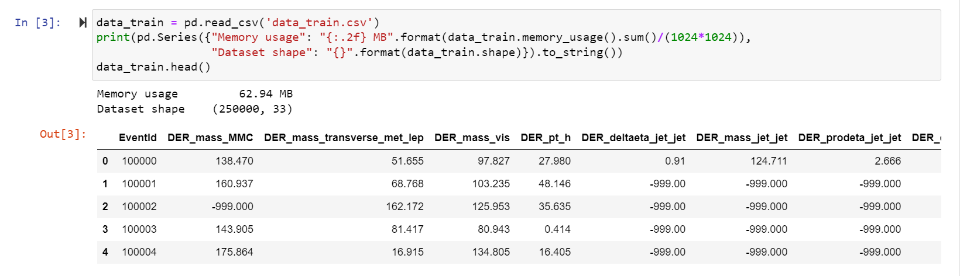
Data set and Data Exploration

Slide 21
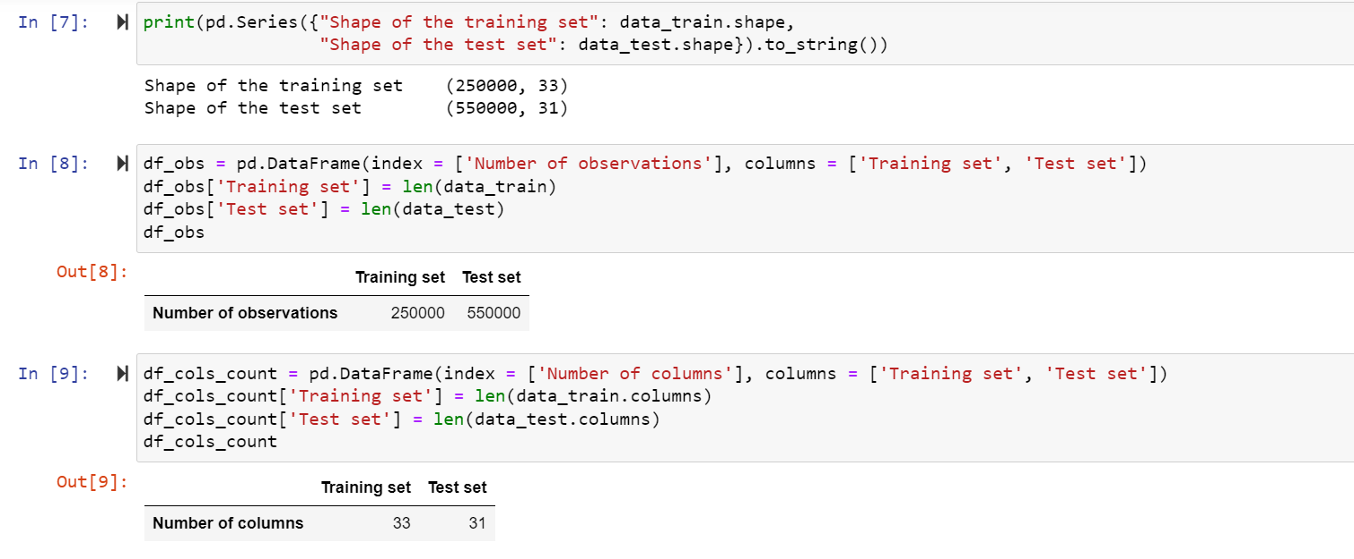

Slide 22
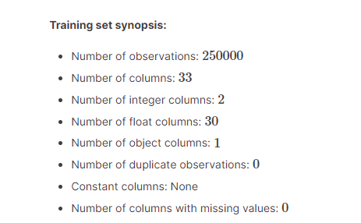

Slide 23
The target Label is a binary variable,
taking values b and s, indicating the status of an event.
b↦background
events↦signal event
Univariate Analysis
Target variables
Predictor variables

Slide 24
Process of Univariate analysis
Function to construct barplot and donutplot of a dataframe column.
Splitting the training by target class.
Number of unique values for the predictor variables.
Proportion of the value -999 in the dataset columns

Slide 25
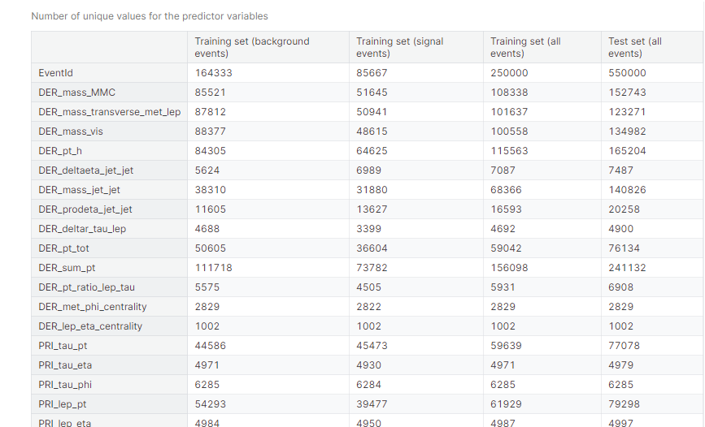

Slide 26
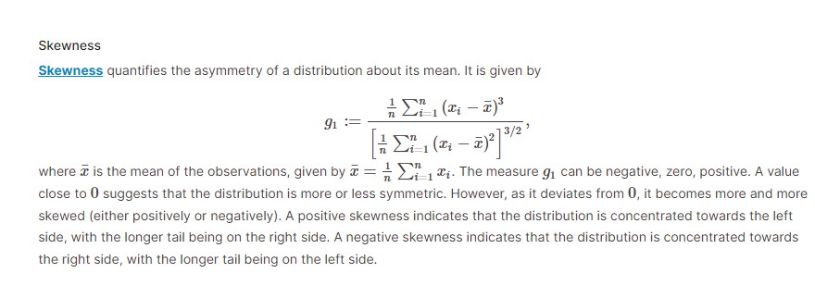

Slide 27
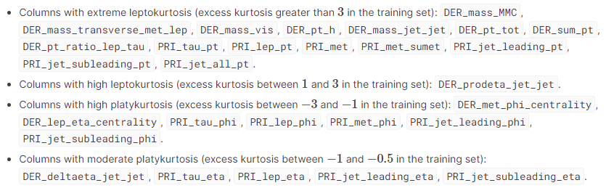

Slide 28
1. Kurtosis Distribution:
- Both background and signal events in the training set have a global peak near 0 in their kurtosis distributions.
- The kurtosis distribution for signal events is more bell-shaped and relatively dispersed.
- In contrast, the kurtosis distribution for background events is highly concentrated around 0 with high peakedness.
2. Skewness and Kurtosis Resemblance:
- There is a notable resemblance between the distribution plots of skewness and kurtosis for background events in the training set and all events in the test set.
- This suggests that a significant portion of the observations in the test set may be background events.
Implications:
- The kurtosis distribution characteristics indicate differences between background and signal events, with signal events having a broader distribution compared to background events.
- The resemblance between the skewness and kurtosis distributions of background events in the training set and all events in the test set suggests that the test set may primarily consist of background events.
- This observation underscores the importance of effectively distinguishing between background and signal events to accurately classify events produced in the particle accelerator.

Slide 29
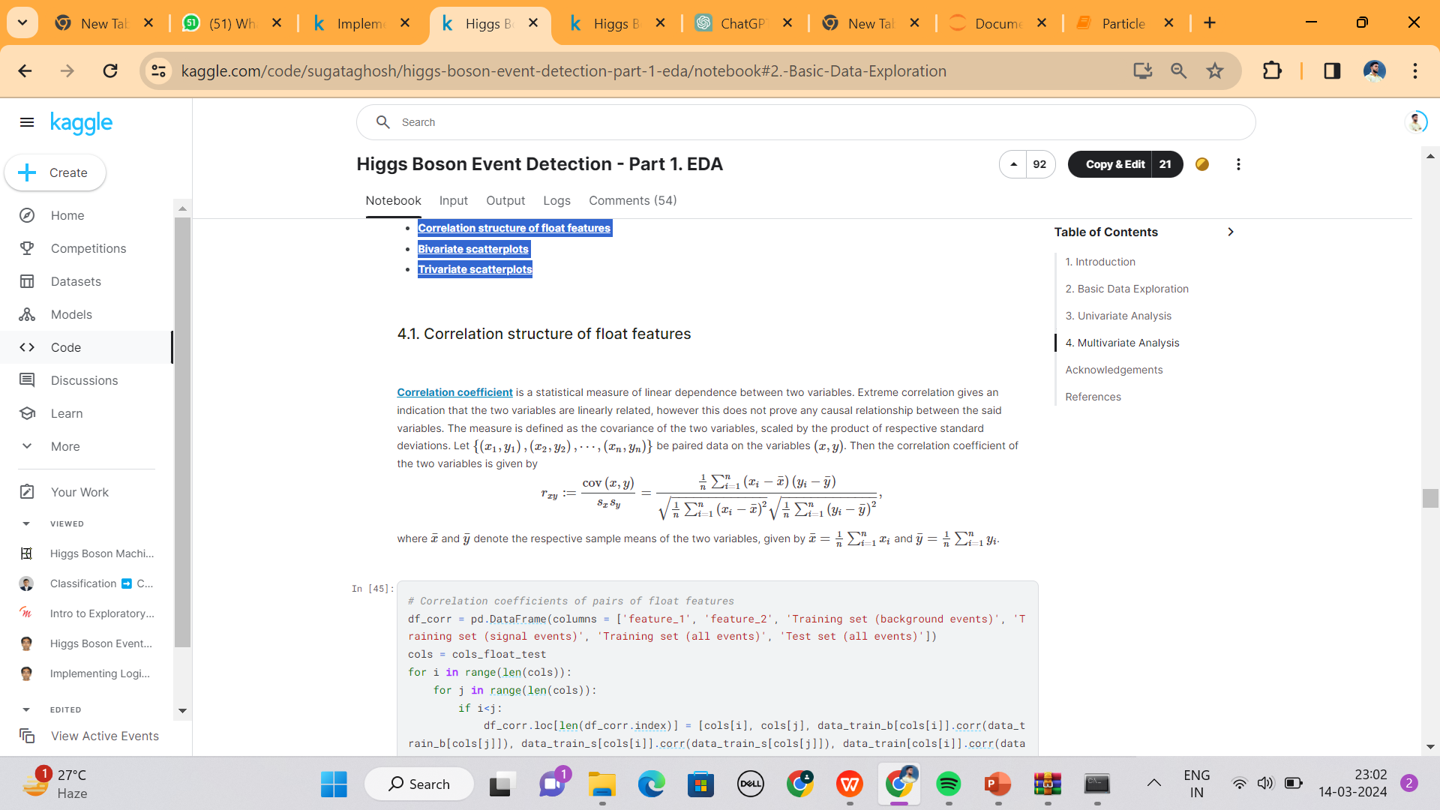
Multivariate Analysis
Correlation structure of float features.
Bivariate scatterplots.
Trivariate scatterplots

Slide 30
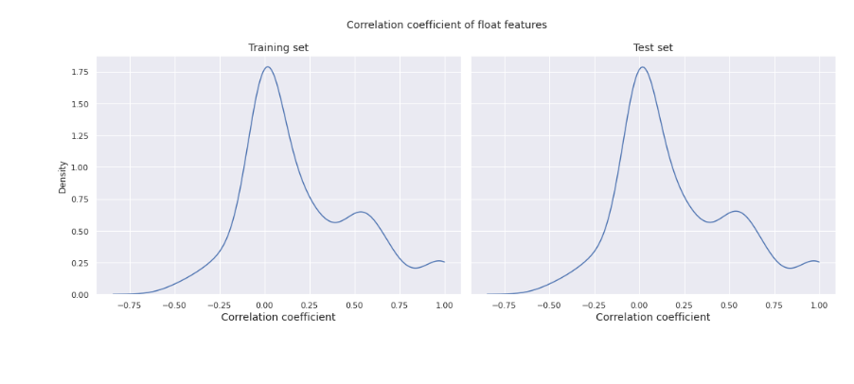

Slide 31
Correlation Distribution:The correlation distribution is almost identical between the training set and the test set.
The density has its highest peak near 0, suggesting that many pairs of features have low or no correlation.
There is a secondary peak between 0.5 and 0.6, indicating a fair number of moderately to highly correlated pairs of features.
Furthermore, there is a noticeable increase in density after 0.8, with a small peak very close to 1, indicating the presence of a few extremely correlated pairs of features.

Slide 32
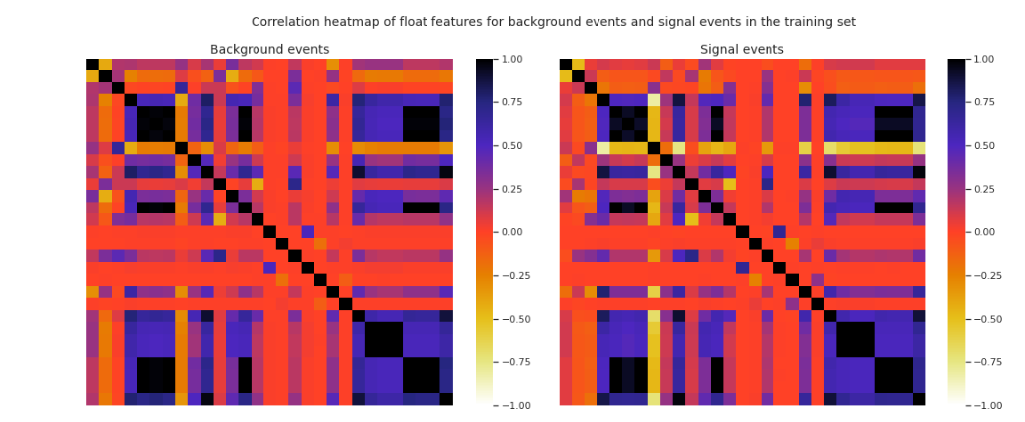

Slide 33
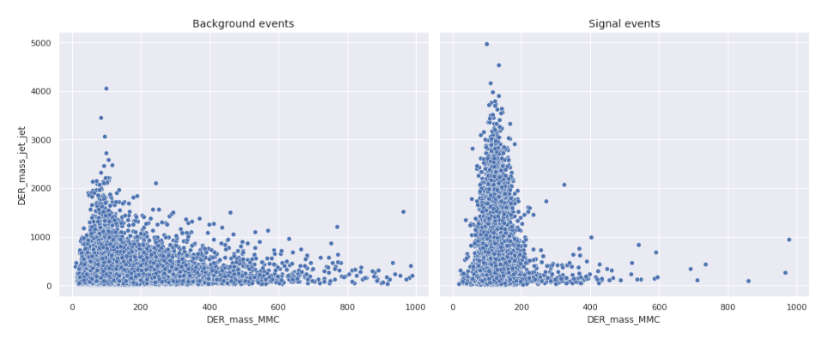
Bivariate scatterplots

Slide 34

Trivariate scatterplots

Slide 35
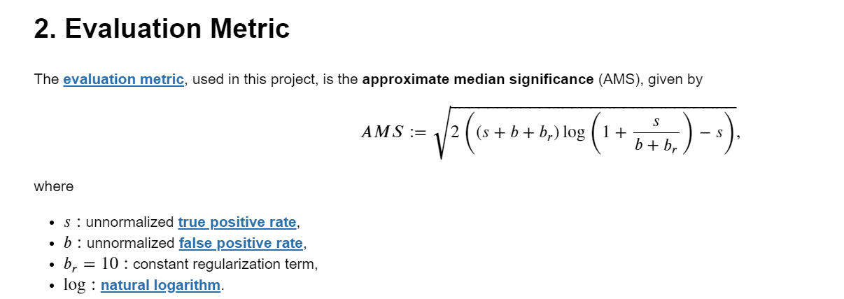

Slide 36
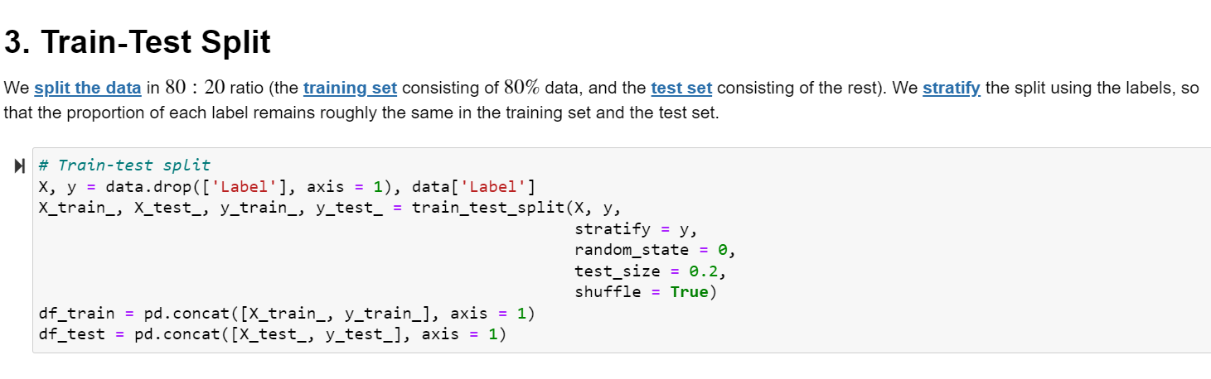

Slide 37
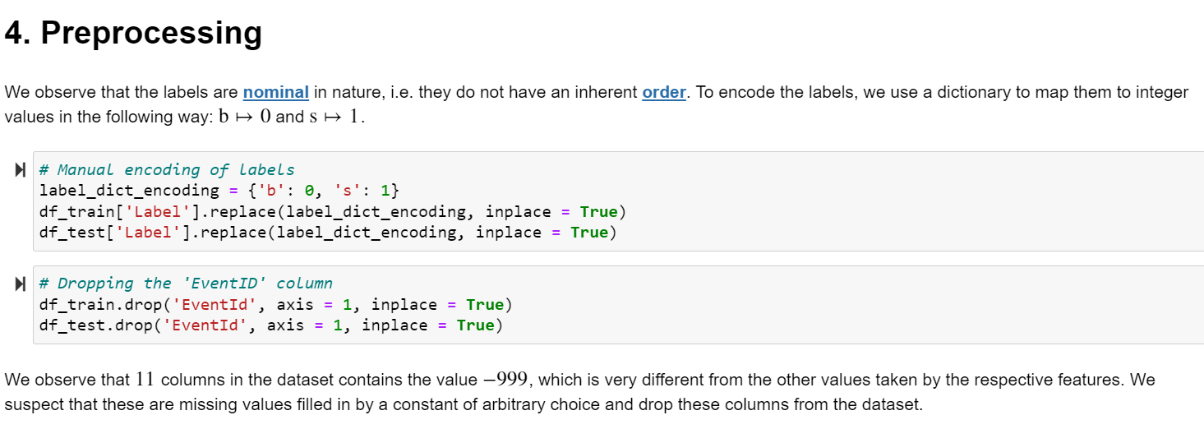

Slide 38
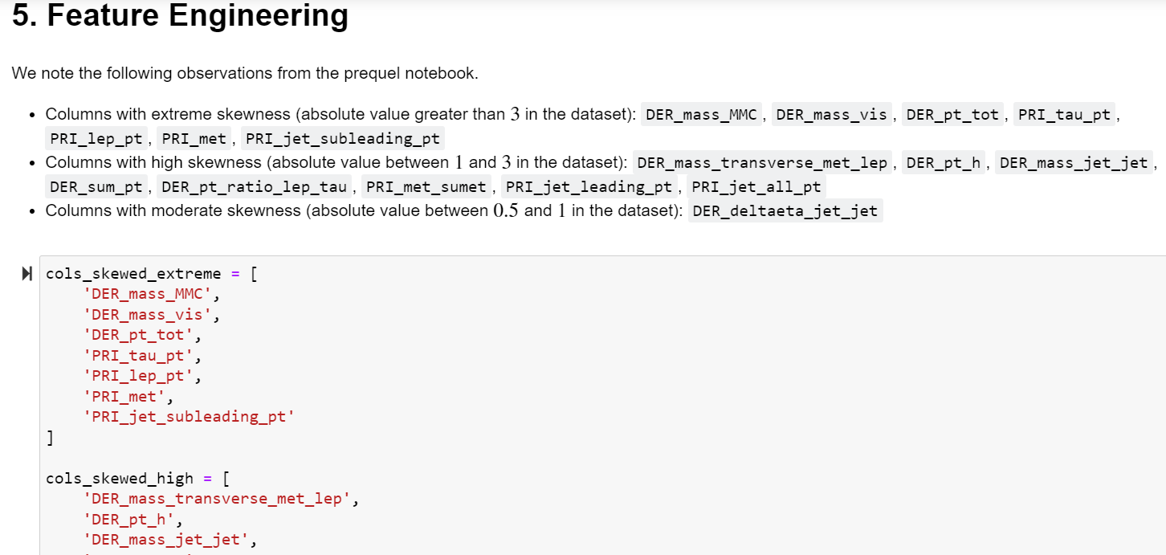

Slide 39
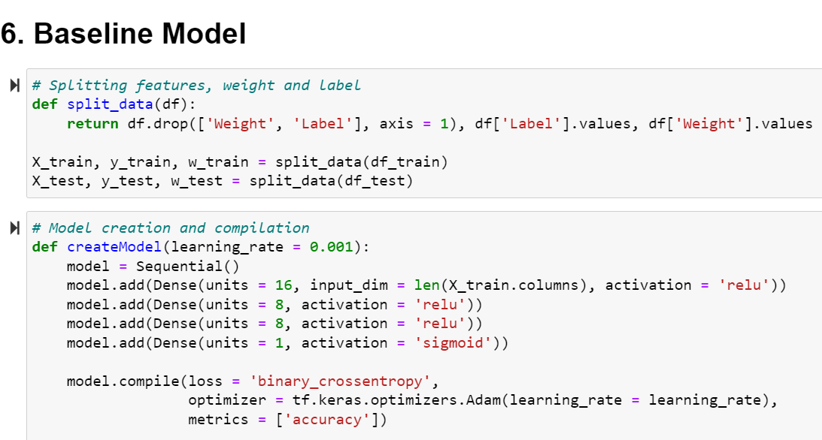

Slide 40
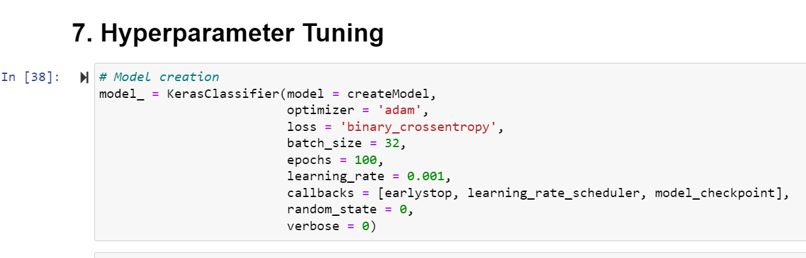

Slide 41
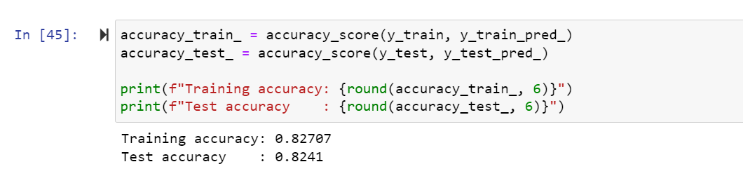
Prediction and Evaluation

Slide 42
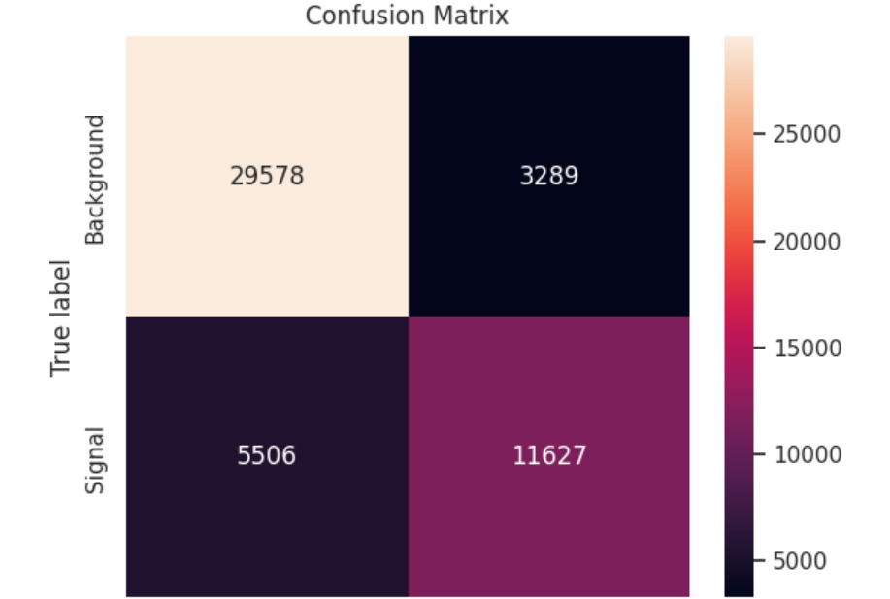

Slide 43
The primary goal of this machine learning project is to develop a model that can accurately predict whether a given set of experimental features corresponds to a signal or background event. Successful classification contributes to the advancement of particle physics research by automating the identification of events that may indicate the presence of specific particles or phenomena.

Slide 44
Conclusion
Interpretation and Validation: Interpret the model's predictions to gain insights into the underlying physics of the particle events. Validate the model's predictions using domain knowledge and, if possible, experimental results from particle physics research.
By following these steps, you can develop a machine learning model that contributes to the advancement of particle physics research by accurately identifying events of interest and distinguishing them from background noise. Remember to collaborate closely with domain experts to ensure that the model's predictions align with the principles and findings of particle physics.

Slide 45


